Slide 1


INTRODUCTION
METHODOLOGY
RESULTS AND DISCUSSION
CONCLUSION
Using Clustering and PCA to Predict TV Show Attributes from Visual Features of Posters
National University - Manila
Renaire Odarve Karl Satchi Navida
Bachelor of Science in Computer Science: Machine - Learning
Advance Machine Learning, Finals Presentation

Slide 2



INTRODUCTION
METHODOLOGY
RESULTS AND DISCUSSION
CONCLUSION
Introduction
Based on the study, it can be concluded that mapping on clusters is not an effective tool in predicting genres on TV show posters. However, machine learning using PCA and clustering algorithms can give patterns that are useful for trend and market analysis.

Slide 3
INTRODUCTION
METHODOLOGY
RESULTS AND DISCUSSION
CONCLUSION
Methodology
Based on the study, it can be concluded that mapping on clusters is not an effective tool in predicting genres on TV show posters. However, machine learning using PCA and clustering algorithms can give patterns that are useful for trend and market analysis.

Slide 4
INTRODUCTION
METHODOLOGY
RESULTS AND DISCUSSION
CONCLUSION
Based on the study, it can be concluded that mapping on clusters is not an effective tool in predicting genres on TV show posters. However, machine learning using PCA and clustering algorithms can give patterns that are useful for trend and market analysis.

Slide 5
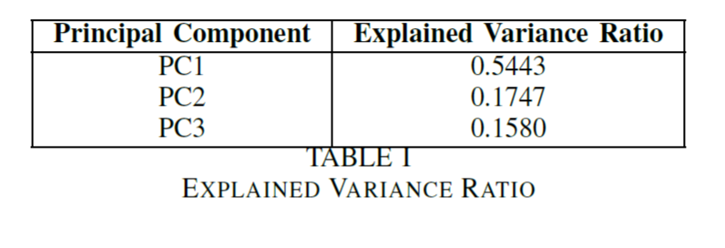
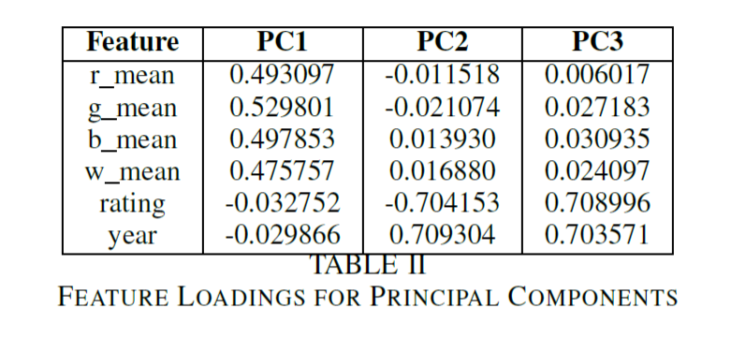
INTRODUCTION
METHODOLOGY
RESULTS AND DISCUSSION
CONCLUSION
Results and Discussion
Explained Variance Ratio
Feature Loadings

Slide 6
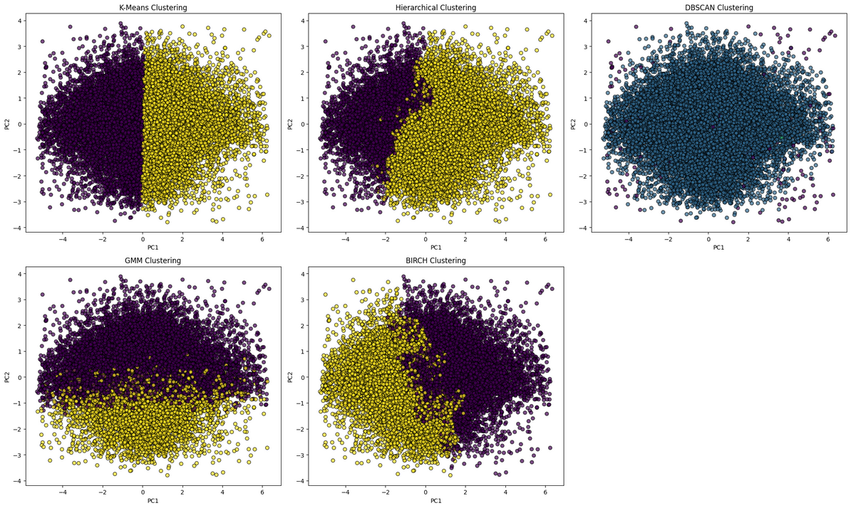
INTRODUCTION
METHODOLOGY
RESULTS AND DISCUSSION
CONCLUSION
Comparison of Clustering Algorithms

Slide 7
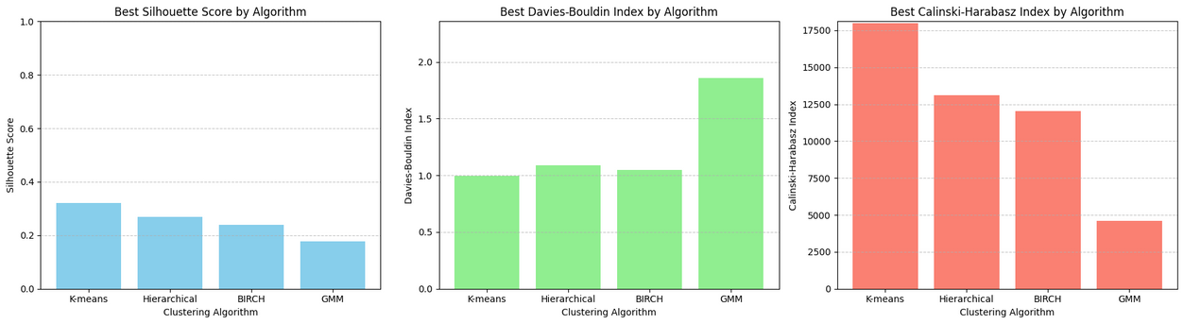
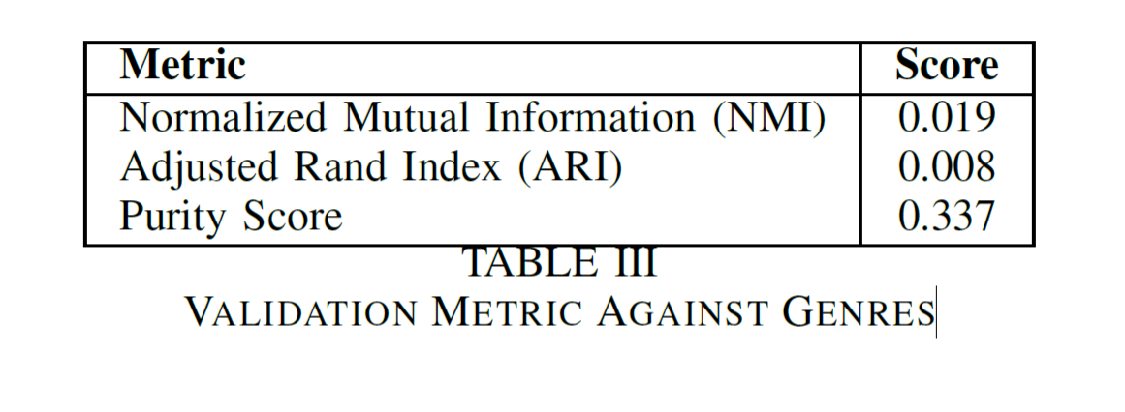
INTRODUCTION
METHODOLOGY
RESULTS AND DISCUSSION
CONCLUSION
Evaluation Metrics of Clustering Algorithms
Validation Metrics For The Best Cluster Against Genres

Slide 8
INTRODUCTION
METHODOLOGY
RESULTS AND DISCUSSION
CONCLUSION
Conclusion
Based on the study, it can be concluded that mapping on clusters is not an effective tool in predicting genres on TV show posters. However, machine learning using PCA and clustering algorithms can give patterns that are useful for trend and market analysis.

